Slide 1

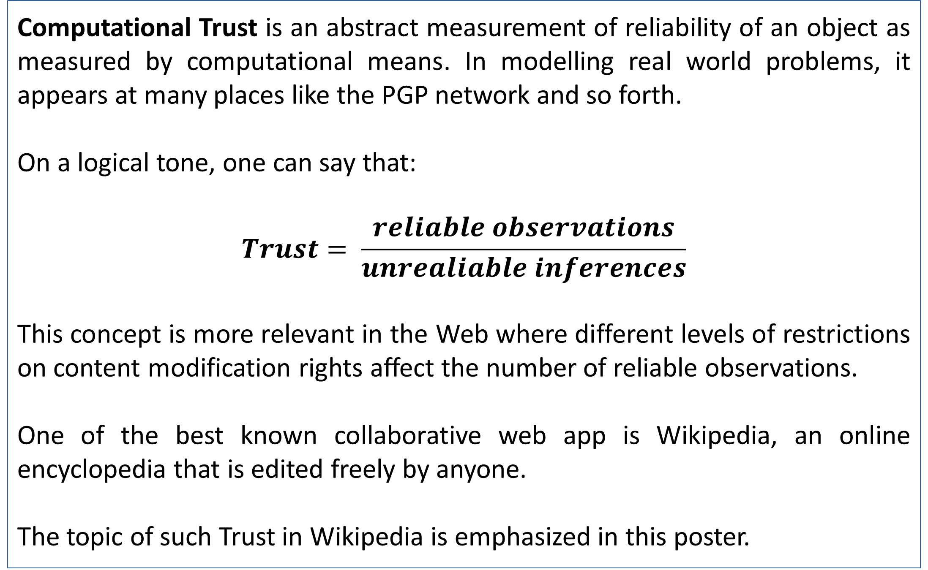
Computational Trust in Wikipedia
Anmol Dalmia
Dept. of Computer Sc. And Engg., National Institute of Technology, Rourkela
Abstract
How Wikipedia Works
Wikipedia is a de facto standard for reference in today’s realm of public Internet. The sheer scale and availability of the encyclopaedic services has made it possible for millions of people to access freely edited data. But this freedom of editing makes the data unreliable to the fullest. Open access and modification rights allow freelance editing as such, which, on one side, provides global fora for information sharing, and on the other side, may lead to undesired consequences borne of inconsistent data via such edits. In this poster, the various notions of trust or reliability and some major concepts of trust modelling in Wikipedia, the largest collaborative web application encyclopaedia, is discussed. Major authors in the field have endeavoured to model data reliability or trust based on various structural and abstract features of Mediawiki systems. Observations regarding such approaches and other phenomena such as plagiarism and vandalism in Wikipedia have also been illustrated to emphasize the need of such measurements in and outside Wikipedia.
Wikipedia, as mentioned, is a freely edited web application. It is a set of webpages that feature knowledge in form of articles, which as mentioned as a top-down list as follows:
Each article is a time series of web pages called edits or revisions.
Each revision is effected by one and only one contributor called author.
Anonymous authors and automatic editing bots can edit pages
An edit can be reverted, that is, a revision can be restored to its immediately previous image, nullifying the effect of the previous edit.
Some articles have a variety of edit counts, ranging from 0 to 1000s.
Chart 1. The abstract organization of a page in Wikipedia
Introduction
Table 1. Comparison of Various models proposed to compute Trust in Wikipedia
Vandalism in Wikipedia
Computational Trust is an abstract measurement of reliability of an object as measured by computational means. In modelling real world problems, it appears at many places like the PGP network and so forth.
On a logical tone, one can say that:
$$Trust= \frac{reliable observations}{unrealiable inferences}$$
This concept is more relevant in the Web where different levels of restrictions on content modification rights affect the number of reliable observations.
One of the best known collaborative web app is Wikipedia, an online encyclopedia that is edited freely by anyone.
The topic of such Trust in Wikipedia is emphasized in this poster.
An important field of Trust computation deals with the involvement of Vandalism in Wikipedia. A vandal edit is an edit where the facts or modifications made do not contribute to enhance the content of the article. Vandalisms occur in Wikipedia most commonly because it is unrestricted and a major cause behind this is that it allows users to make edits anonymously, thus providing a free edit right, that can be easily misused.
Vandalism obviously makes an article more unreliable, thus decreasing it’s trust value. More often than not, it can be obfuscated easily. For example, it may be stated that Fissible Uranium has an atomic weight of 238, which is untrue and an application of the fact referenced may cause damage to human life.
This indicates Vandalism as one of the biggest markdowns in Trust Valuation.
Various models of Trust
To measure Trust in Wikipedia, many different features have been identified that play the same roles as a human’s psychology does when it assigns trust to a particular object. These features may include: how long an edit survives after it is made, who has created it, what are the details of its creation, etc.
Broadly, considerations about an articles creators and the content present in it and so provided by the housekeeping data of Wikipedia are the most important features. Some of these have led to inventions of many other methods, such as one involving Game Theory.
The most popular of these models was given by Adler et. al. It is based on the simple premise that a fact stated true is not opposed as fiercely as an untrue statement.
Nevertheless, a comparison has been illustrated in Table 1.
Conclusion
From the discussion above, it is clear that computing trust for Wikipedia is of importance as far as reliability of contained information is concerned. However, there are a few hurdles involved:
Cost incurred due to extensive computational facilities needed
Poor recordkeeping about deleted revisions
Imperfect trust modelling
It is expected that in the coming years, principles of Artificial Intelligence and Machine Learning provide better scope for trust modelling and computation. Till then, it’s a matter of time.
Figure 1. Comparison of Restrictions on collaboration in various web applications. Wikipedia appears
as one of the most freely collaborated application on the Web
Submitted by:
References
Anmol Dalmia
712CS2043
Seminar and Technical Writing
B. Adler and L. de Alfaro. A content-driven reputation system for the Wikipedia. In WWW `07: Proc. of the World Wide Web Conference, 2007.
2. J. E. Blumenstock. Size matters: Word count of a measure of quality on Wikipedia. In WWW '08: Proceedings of the 17th International Conference on the World Wide Web, pages 1095{1096, 2008. (Poster paper).
B. T. Adler, L. de Alfaro, S. M. Mola-Velasco, I. Pye, P. Rosso, and A. G. West. Wikipedia vandalism detection: Combining natural language, metadata, and reputation features. In CICLing `11: Proc. of the 12th Intl. Conf. on Intelligent Text Processing and Computational Linguistics, 2011.
4. S. D. Kamvar, M. T. Schlosser, and H. Garcia-molina. The EigenTrust algorithm for reputation management in P2P networks. In Proceedings of the Twelfth International World Wide Web Conference, 2003.

